Slide 1
Open Geographic Data and Libraries
Dave Rowe

Slide 2
GIS Data
Points: Individual locations made up of a single coordinate set e.g. a Library.
Lines: Linear features made up of coordinates e.g. a Road
Polygons: Bounded areas (shapes) made up of coordinates e.g. a County Council.
Geocoding: Address -> Geo-coordinates. Example: Putting a library on a map from it's address.
Reverse geocoding: Geo-coordinates -> Address. Example: taking coordinates retrieved from GPS to determine current location.

Slide 3
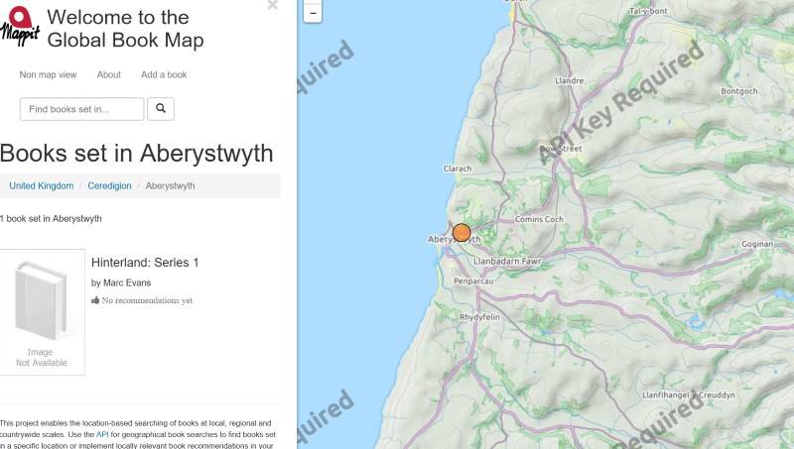
Books set in a location
Data that includes geography and libraries is always fun!
A web application called Mappit creates a 'Global Book Map'.

Slide 4
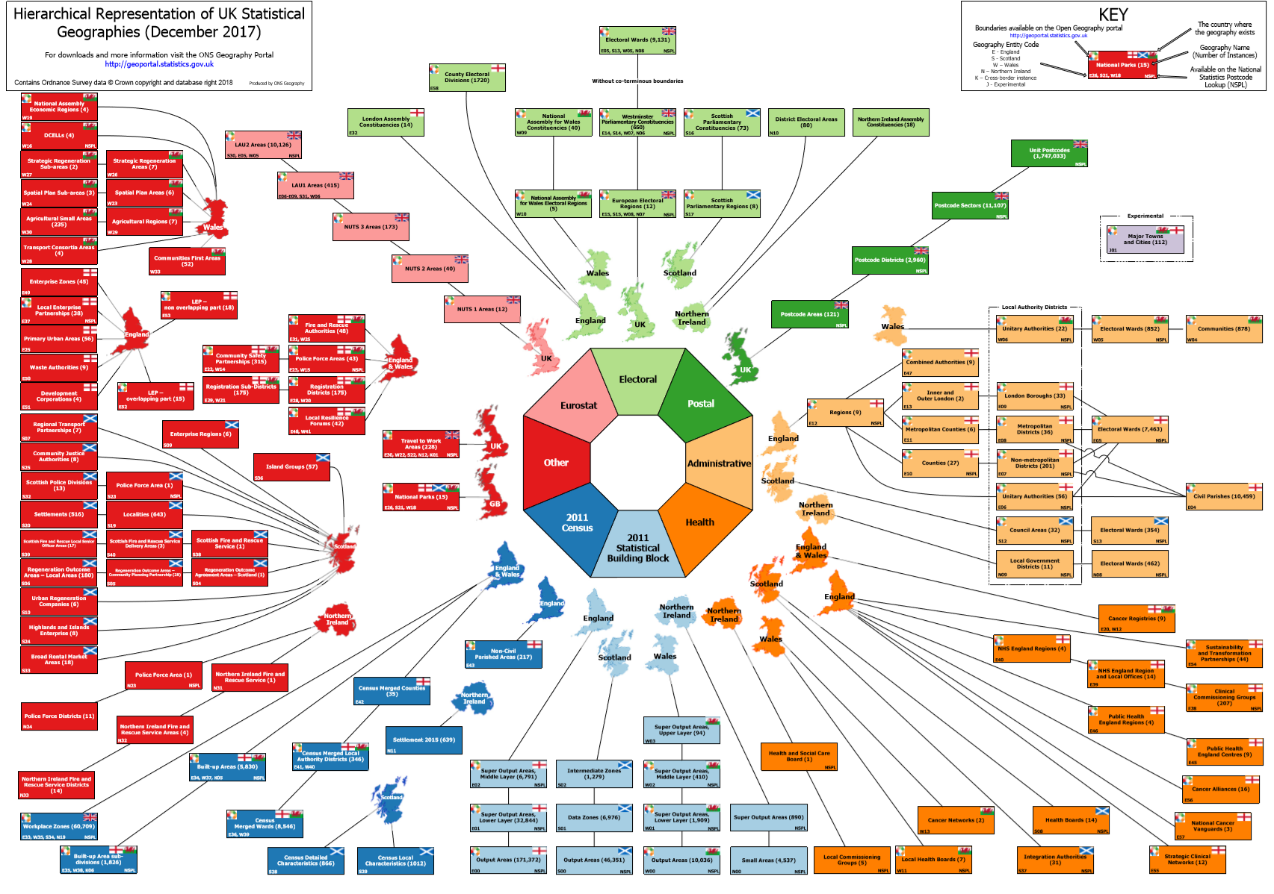
Geographical boundaries in the UK

Slide 5
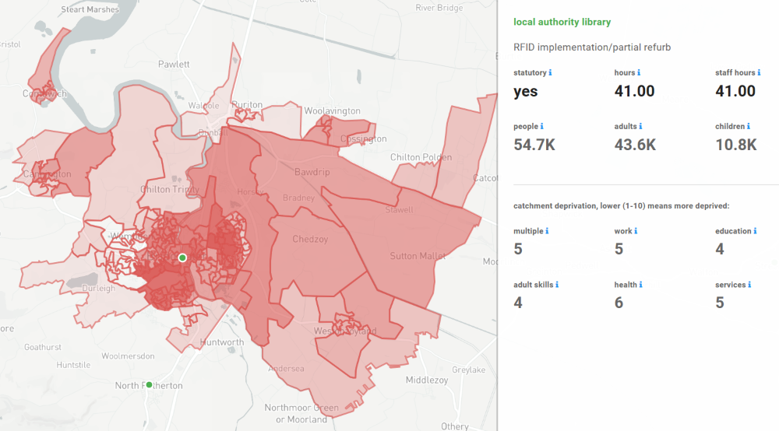
England
Using the Libraries Taskforce Libraries in England dataset.
Percentage of the population within certain distances
Estimated catchment areas of the libraries, and the profile of the population within that catchment
Comparisons between authorities such as number of libraries relative to area, or relative to population

Slide 6
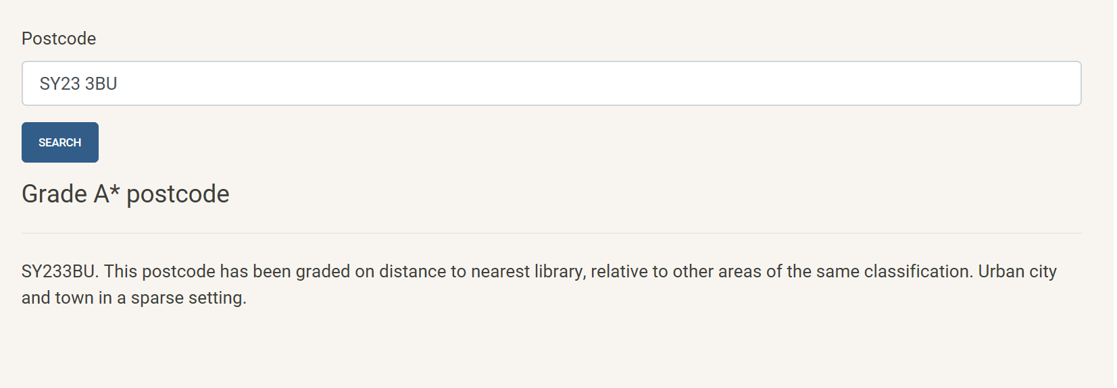
Postcode Lottery
‘How close' a library is is not comparable between different areas.
People in very rural areas don't necessarily expect very close access to a library (though they should have access to library services).
People in urban areas may expect a library to be part of the immediate services in their town/city.

Slide 7
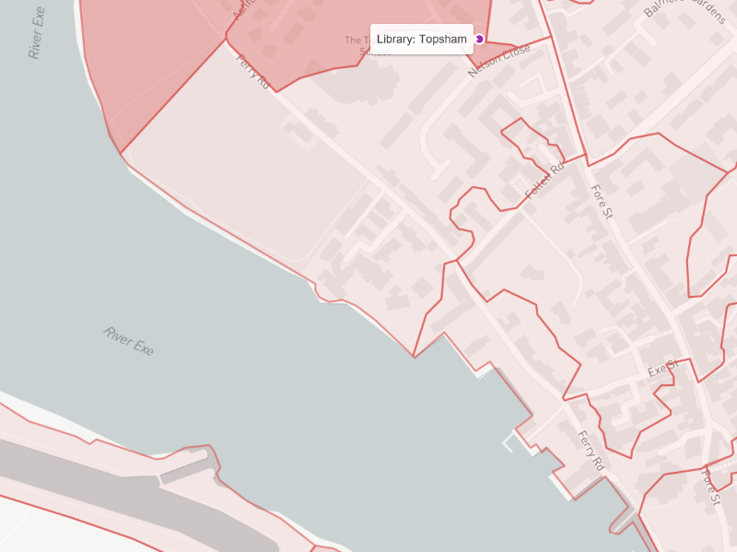
Routes
What if there is a big river between you and a library? It may be the nearest, but it may also be a long round trip to get there.
What about different travel types and accessibility? 3 miles on a motorway is very different to 3 miles across a city. Some routes may not be pedestrian.

Slide 8
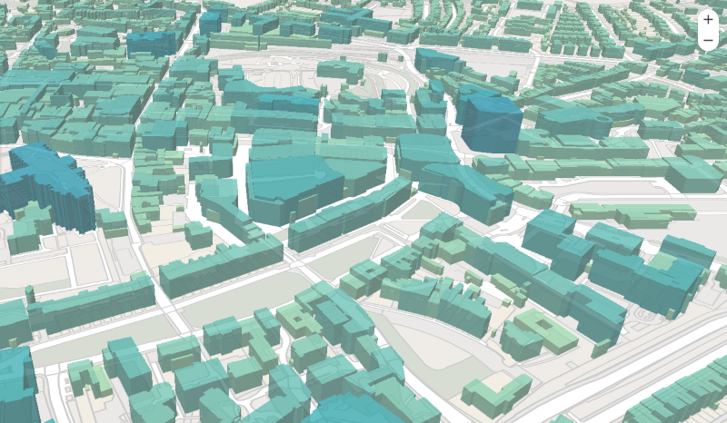
LIDAR and 3D
Light Detection and Ranging (LIDAR) is an airborne mapping technique, which uses a laser to measure the distance between the aircraft and the ground.
Using LIDAR data we can determine an average height for buildings, which aids in creating 3D maps that display building heights.

Slide 9
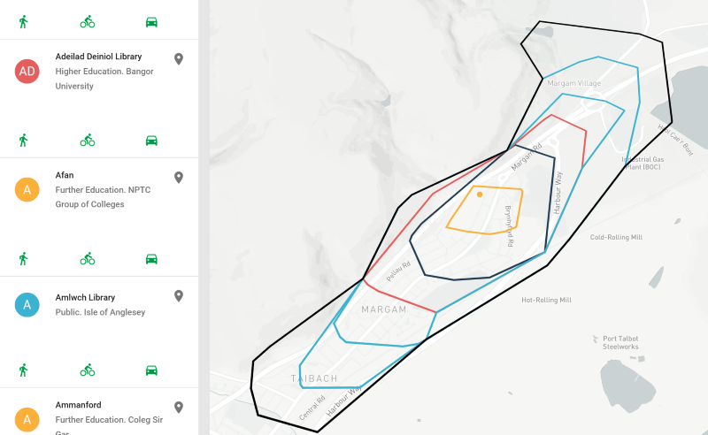
Wales
CILIP in Wales have been compiling a list of libraries (Further Ed, Higher Ed, Health, Public, Research) and loading these in to WikiData so they can be maintained by anybody.

